Slide 1


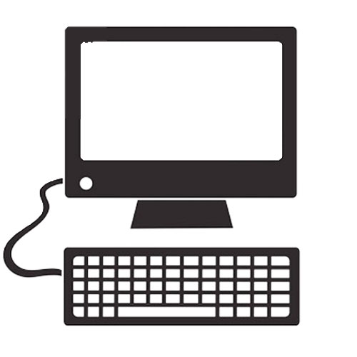
Cloud Computing Data Center
Sensor
Compute device
Sensor
Sensor
Sensor
Compute device
Sensor
Sensor
Presentation devices

